Slide 1
Curious YouT Project main idea We developed our Youtube analytics in 3 modules. 1. Login page via OAuth 2.0 2. Youtube analytics 3. Youtube search

Slide 2
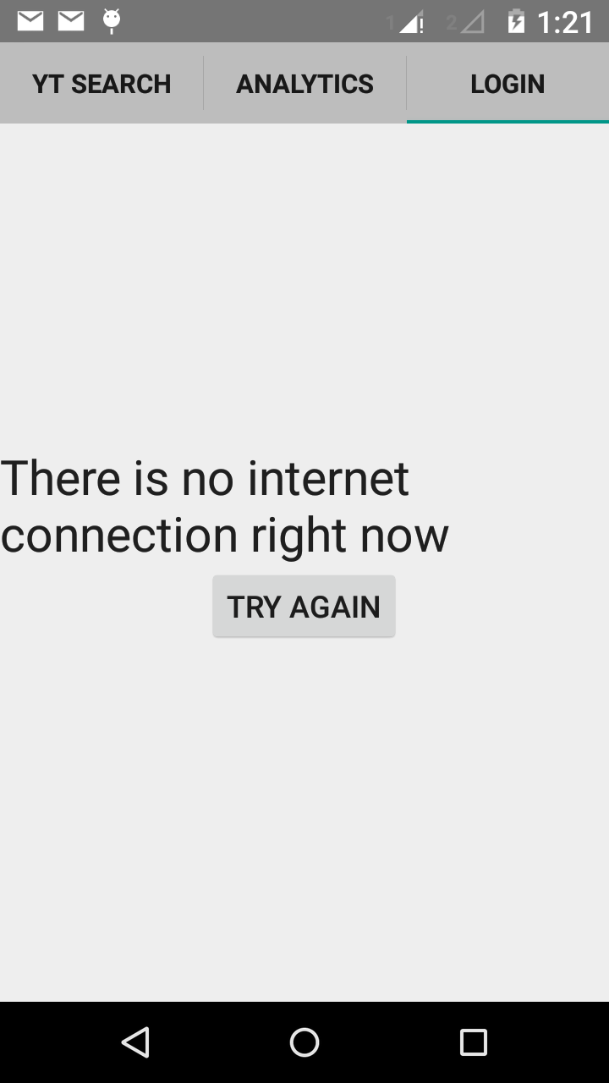
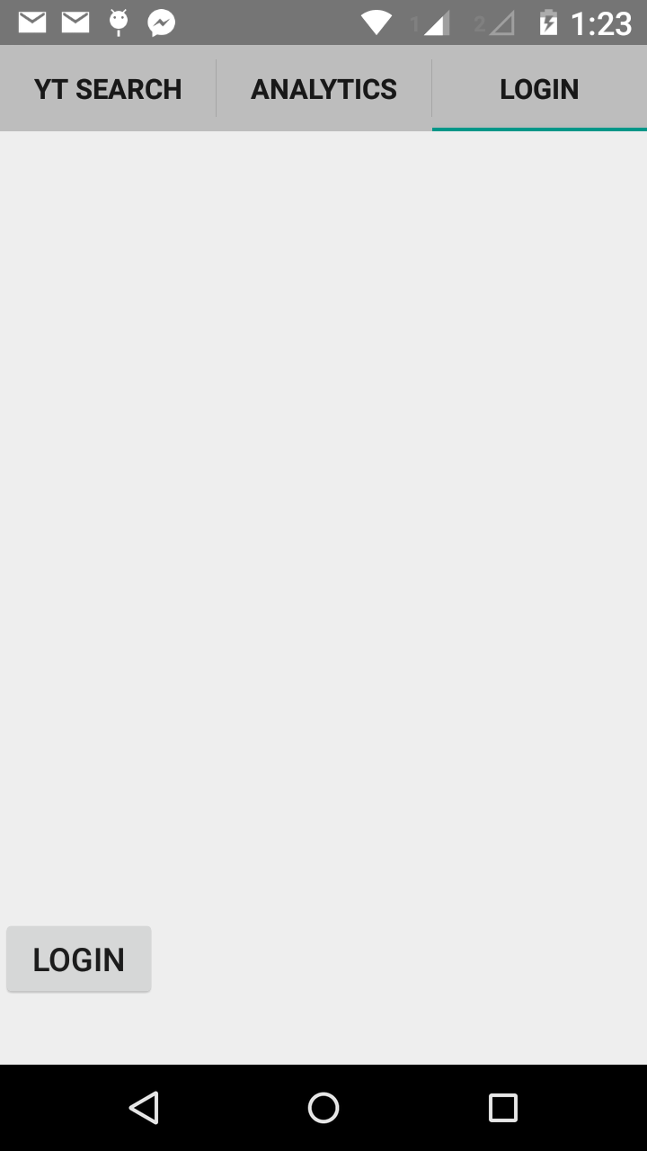
Login page
We display the error message if there The login button is displayed if internet no internet connection. is present.

Slide 3
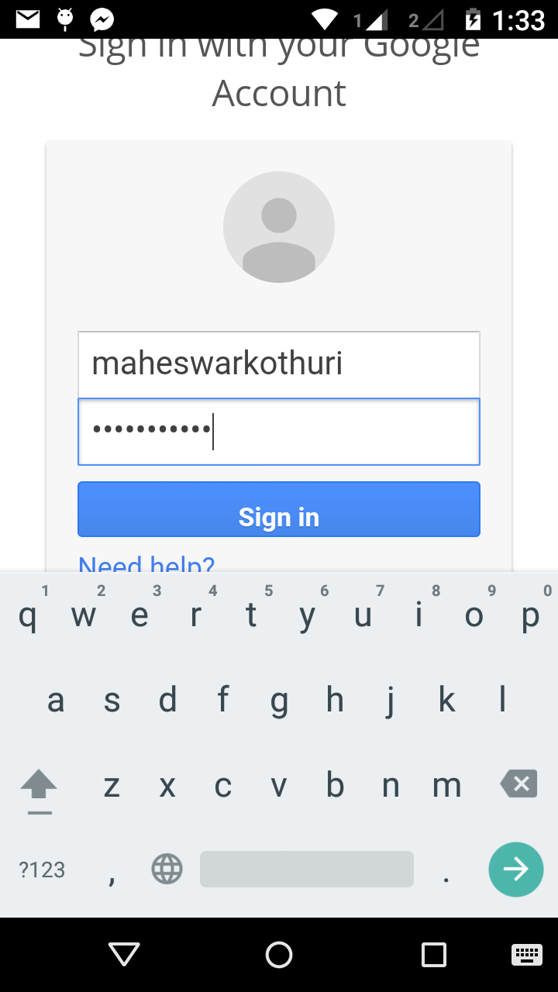
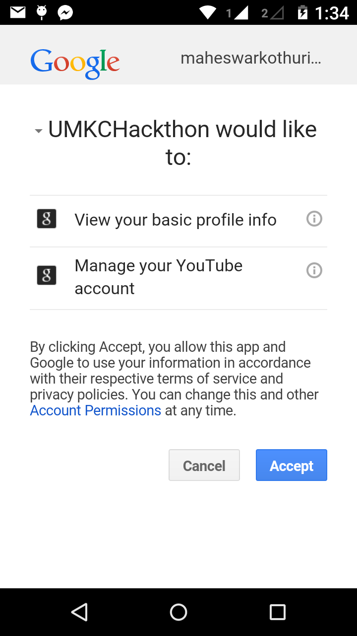
As soon as we login it redirects to Google Account sign in page
OAuth 2.0 Authentication
Here we can manage Youtube account and view profile.

Slide 4
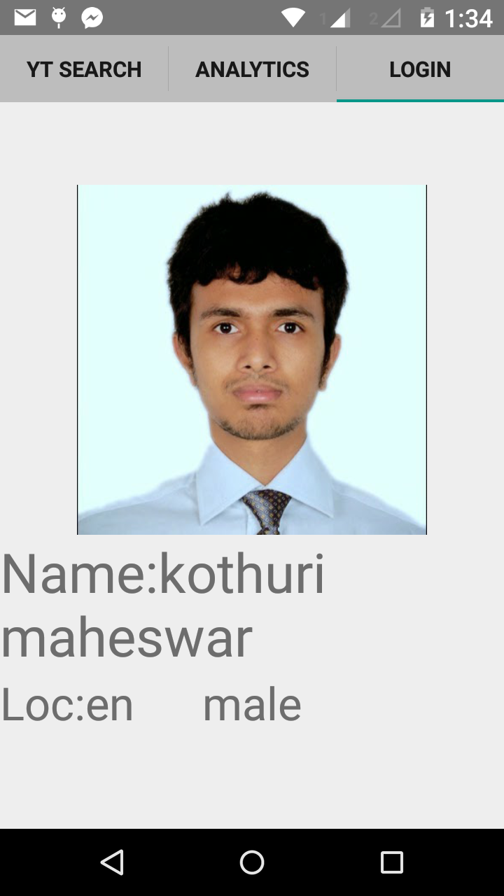
The user profile page is redirected as shown below
Getting data from youtube account and
Storing and displaying in our application.
In the Login TAB.

Slide 5
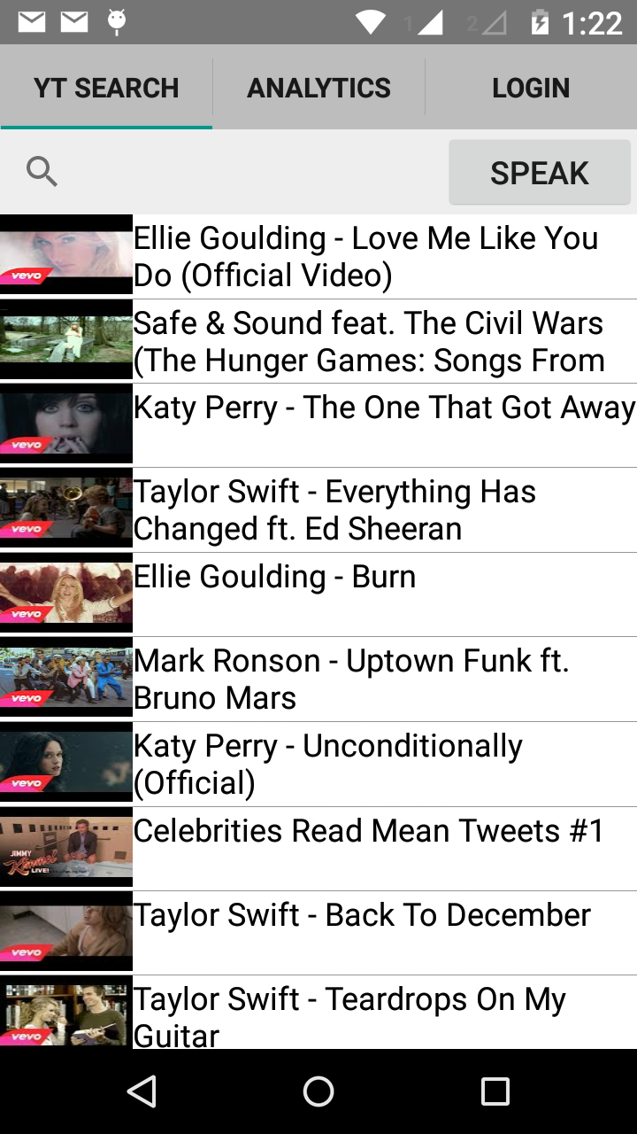
Youtube search
Youtube search will have text search option and speak option. The speak option we developed is simply very good. It recognizes our voice and it is able to produce reliable results.

Slide 6
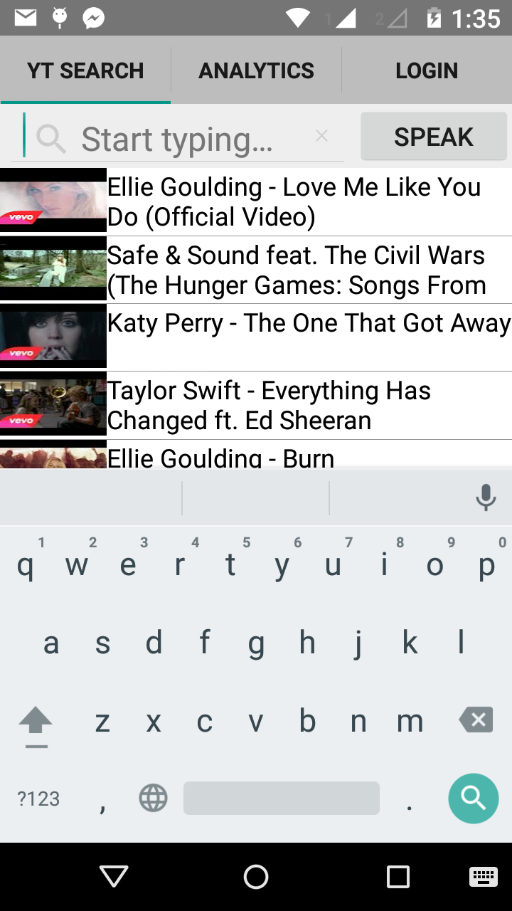
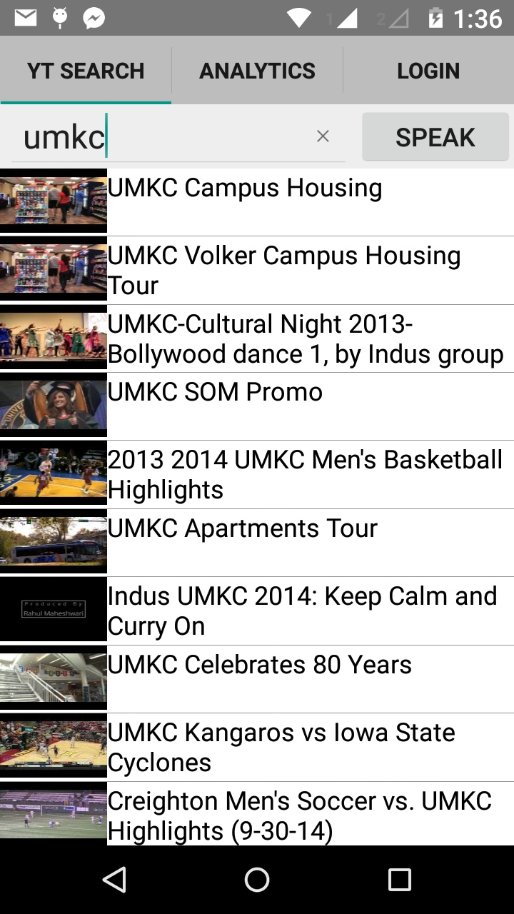
The below screen shots show the text search option
Keyboard Based Search
Voice Based Search

Slide 7
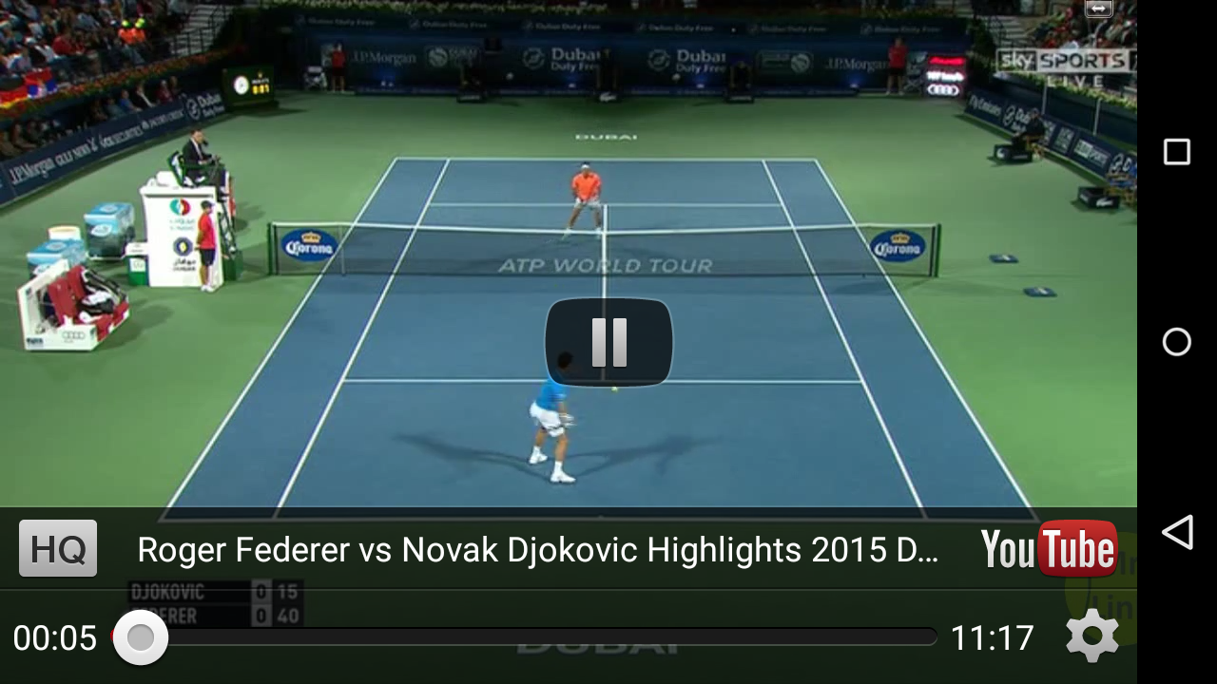
The below screen shot is the video played when we asked for Roger Federer’s videos.
This part done by using YouTube DATA API Version 3

Slide 8
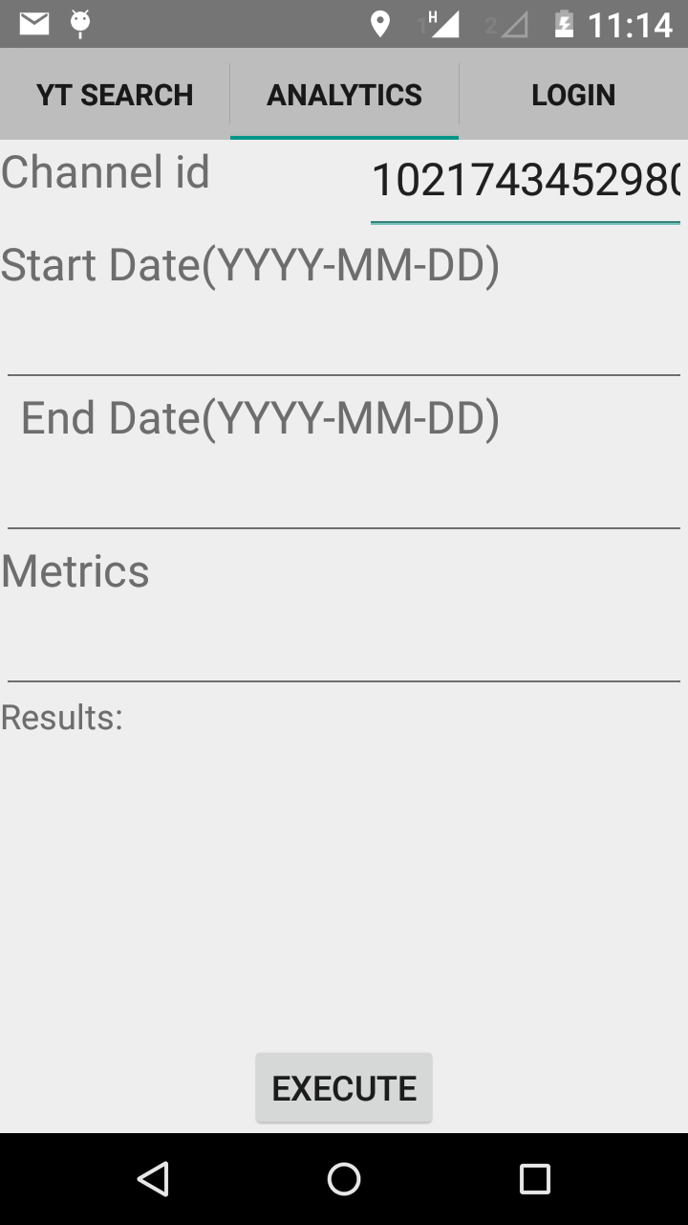
Future Implementation
We started using the YouTube Analytics API for increasing the accuracy of search results, but due to time constraints we are unable to do finish it. What we had in our mind was to generate an effectiveness score of every search result returned by YouTube data API. For doing so we have to query YouTube databases using analytics API for getting views, likes, dislikes, estimatedMinutesWatched, annotationsClicks, annotationsCloses, we will be breaking the effectiveness score into 5 different parts where 20% will be given to likes/dislikes ratio, another 64% for annotation clicks, 16% for views. Some part of the score will be reduced if the views/annotationCloses ratio is high. By generating this score we will rank every video and we will be sorting the results based on this score.

Slide 9
Contraints and Tech Stuff
1)Application will not work with lower version of HoneyComb version of Android OS
2)Application will work with or higher versions of HoneyComb to Lollipop (Latest)
3) IDE : Android Studio
4) Languague: Java
5) Libraries used: 13 (Includes YouTube Data V3 API)

